Slide 1
UMKC Community Application
Group 17
Luke Talcott, Brahian Ramon, Irvin Jimenez-Solis, Jose Fonseca

Slide 2
Introduction
Our Group is composed of transfer/foreign students
We all had a hard time familiarizing with UMKC
And we had a lot of questions about the place, especially due to covid forcing us online for a good chunk of time
Notes:
A majority of our group are transfer/ foreign students
Not too familiar with umkc
Where can I ask questions.

Slide 3
Background
The process of getting acquainted with the campus area is hard
In order to solve this situation, we agreed on building this community tool
Goal in mind to provide students with information such as:
Campus
Parking
Classroom
Interesting places.

Slide 4
The Idea
Create a social app that allows for easy interactions with other students or members of UMKC campus
Some things we wanted to Include:
Meet new people
Find clubs
Activities around campus
Notes:
This could be used for many different reasons. One of them is for meeting
new people on campus such that if someone is new and looking for some people to connect with
or if you are just looking for someone to get some help with some questions about campus.
Another reason this app could be useful is to make it easier to locate things or get
recommendations about something you are looking for or different things that could be useful.
This can also be very helpful now that we are just getting out of a pandemic for people to get
back to a normal campus lifestyle. The application would just be a simple social app amongst
UMKC campus members and students that makes it easier to adjust to the UMKC campus.

Slide 5
Approach
Needed something with appealing and easy to use UI components
One of our members was knowledgeable with React
Spent time researching and learning React
React:
Easy to learn
Many UI components for the interface
Flexibility

Slide 6
Features Focus
Visually appealing
Accessible
Friendly UI
Messaging system
Open forum
User accounts
Tags / keywords

Slide 7
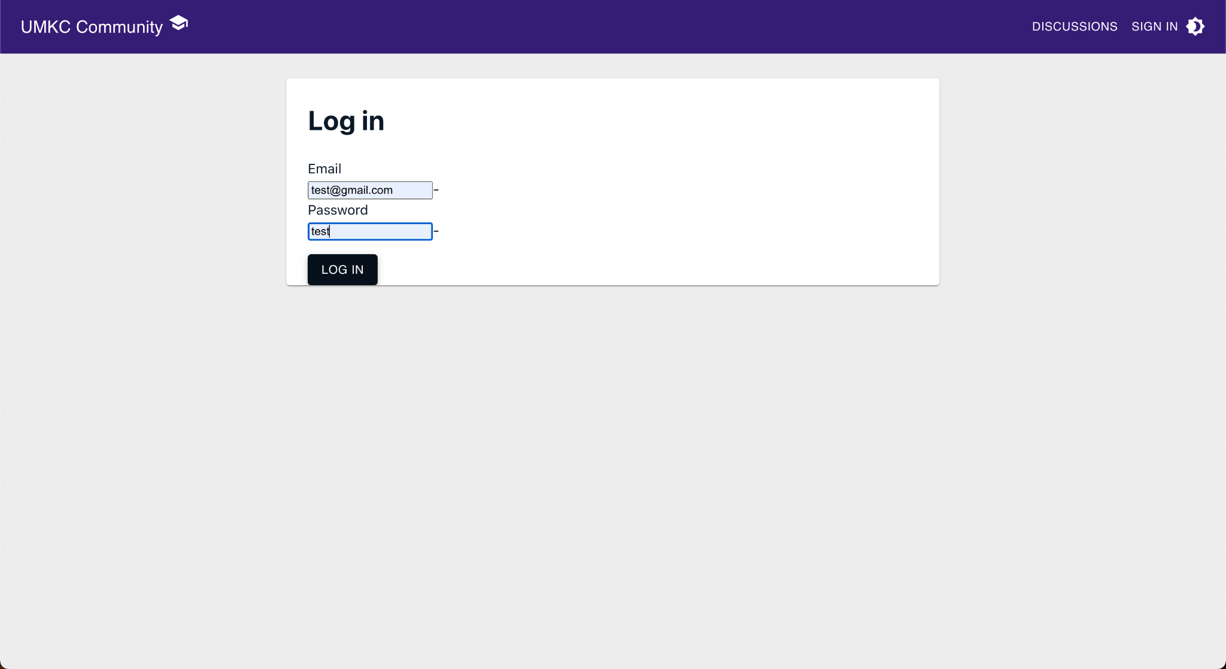
Login
Login page is linked to a Database
User security
Email and Password for Login

Slide 8
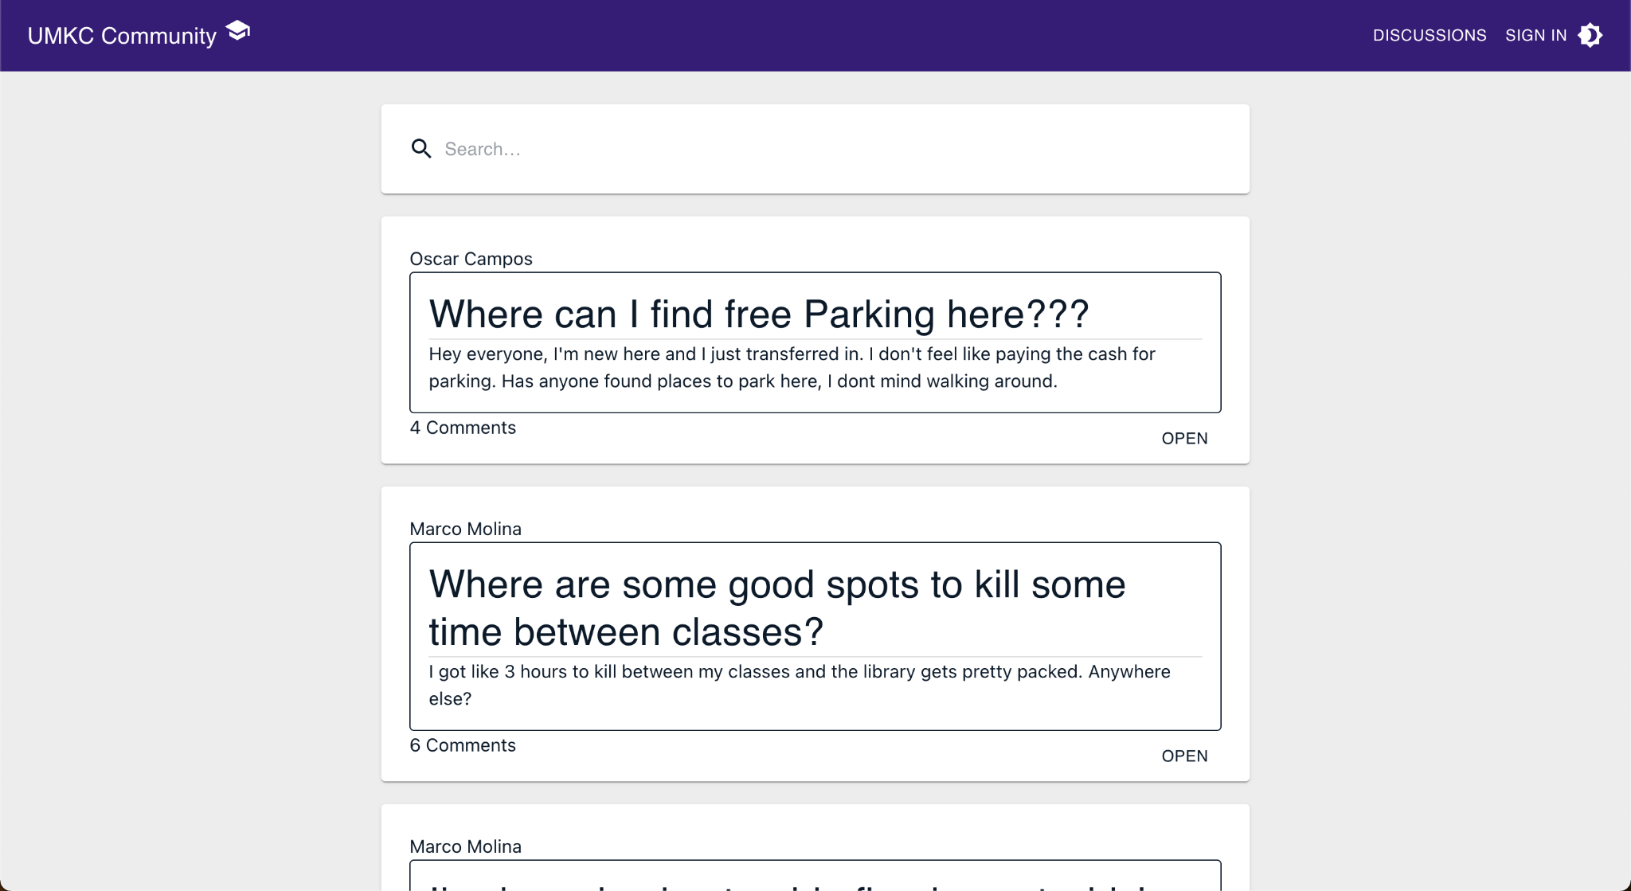
Discussion Board
Features:
Search option
Dynamic navbar
API for fetching latest post
Post liking and comment

Slide 9
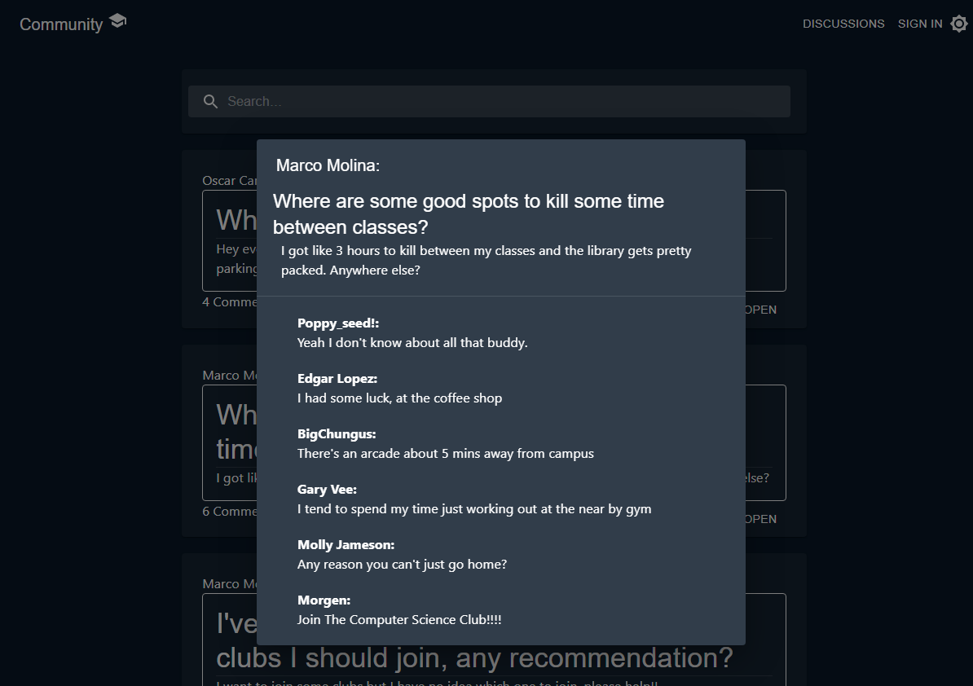
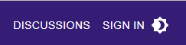
Dark Mode
Option for Dark Mode
Button for toggling between light and dark
Always accessible

Slide 10
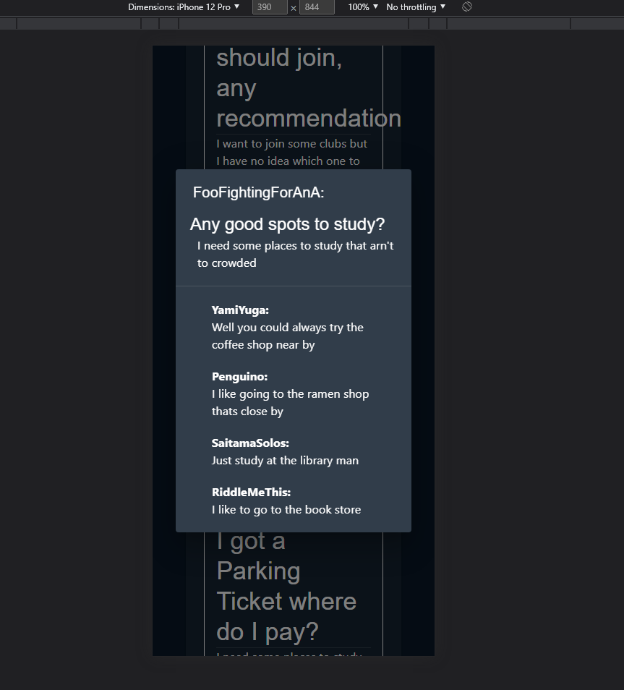
Mobile View
Allows for usability on mobile devices
Adjust size to to fit whatever screen size

Slide 11
Future implementations
Allow for private messaging between users
Integration of a community board where local events can be added
More customization of profile (i.e. profile image, bio, and hobbies)
Creation of community groups, for classes, clubs and organizations
Notifications for the user

